Slide 1
Ecology and Environment

Slide 2
ECOLOGY AND ENVIRONMENT
LIFE DOES NOT OCCUR IN A VCACUUM
EVERY LIVING ORGANISM IS SURROUNDED BY MATERIALS AND FORCES.
FOR ITS SURVIVAL, A PLANT, AN ANIMAL, OR A MICROBE CAN NOT LIVE COMPLETELY SEALED IN AN WATER-RESISTANT SKIN OR SHELL.
EACH LIVING ORGANISM HAS TO DEPEND AND ALSO TO INTERACT WITH DIFFERENT ABIOTIC AND BIOTIC COMPONENTS

Slide 3
The Abiotic Components
WATER
CARBON DIOXIDE
CALCIUM
OXYGEN,
CARBONATES
PHOSPHATES
AN ARRAY OF ORGANIC COMPOUNDS

Slide 4
THE BIOTIC COMPONENTS
PLANTS,
ANIMALS
MICROBES

Slide 5
WHAT IS ECOLOGY ?
‘Ecology’ is the scientific study of the inter-relationship of living organisms
Ecology mainly concerned with the directive influences of abiotic and biotic environmental factors.
Above all ‘ecology’ is the science which investigates organisms in relation to their environment

Slide 6
WHAT IS ENVIRONMENT?
The term ‘Environment’, which etymologically means - ‘surroundings’.
The environment includes other living things, temperature, wind, electricity etc.
Environment consists of both biotic and abiotic substances.
Environment creates favourable conditions for the existence and development of living organisms.

Slide 7
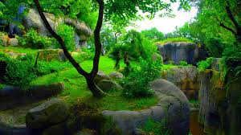
Environment is a very broad concept. Everything that affects an organism during its lifetime is collectively called its ‘environment’.
The inter-dependence and interrelationship of living organisms - plants, animals and microbes with each other and with their physical environment may be expressed in the next slide

Slide 8
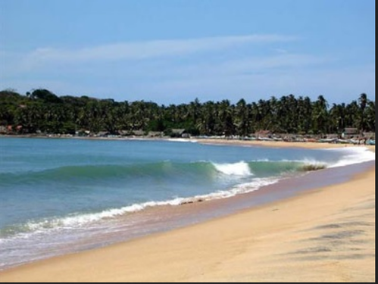
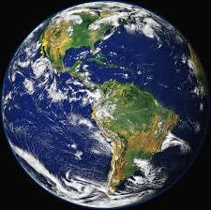
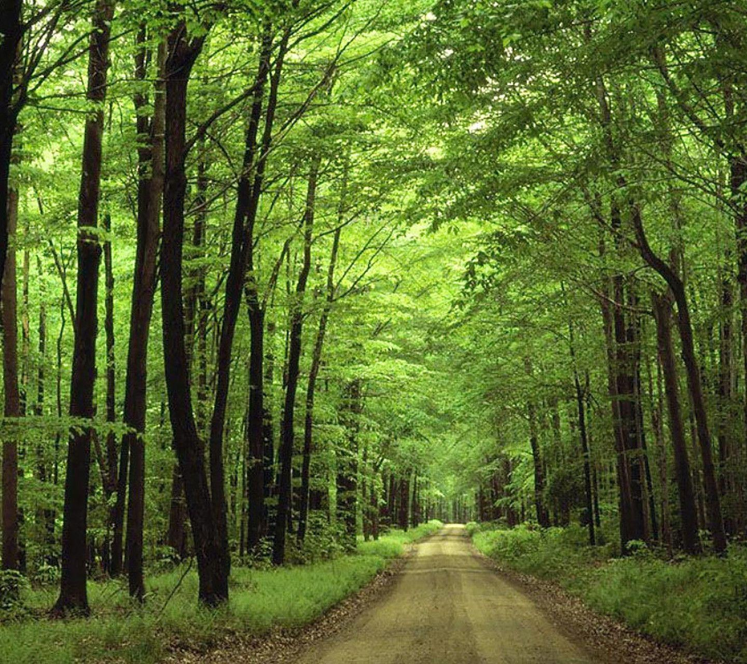
FOREST
Each trees- organism
Together all trees- Population
Plants and animals- Community
Ecosystem
A costal Ecosystem
Organisms
&
Their Environment
The Biosphere
Entire Ecosystem

Slide 9
Conclusion
The abiotic environment is linked to living organism in terms of energy flow and' various bio-geochemical cycles.
So, living organisms depend upon air, water and land for their survival and entire unit is responsible for the existence of living organism or biosphere
Thus the environment is the sum of all these living and non-living things. And Ecology is the scientific study of their mutual relationship. That is why ancient Indians believed nature/Earth as “Mother”.

Slide 10
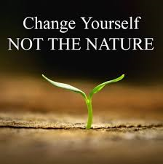
Thank you

